Slide 1
Final Test (25%)– in class (week 10)
Covers everything from week 1 – 9
Review PowerPoint’s, videos, articles and online assignments (including Health & Safety)
Multiple choice and short answer
40 multiple choice and 5 short answer
total of 60 marks
Will go over tips next week!

Slide 2
INTERVIEWING

Slide 3
Before Anything Else,
Preparation is the
Key to Success!
Alexander Graham Bell

Slide 4
Preparing for an Interview
Research Company
What do they do? What products or services do they supply? Any interesting projects?
Know your strengths for the position
Be prepared to prove them/back them up
Know the role and job descriptions
Practice, practice, practice
Mock interviews, video tutorials, practice with friends or family, etc.

Slide 5

Interviews are a two way street!

Slide 6
Goodwill Industries
http://www.youtube.com/watch?v=vuDCk61faXg
http://goodwillekl.com/p/387/l/441/t/Goodwill-Essex-Kent-Lambton-%7C-About-Us

Slide 7
Why Research a Company?
Helps in the selection of prospective employers at the application stage
Develop better cover letters and resumes – targeted!
More effective in an interview – sell yourself in terms of relatable strengths and skills
Employers have an expectation that you are aware of their services, products, locations, current events etc.
Assists you in making informed employment decisions
Notes:
Help in the selection – do the research and find out what their employee culture is like and if you think this company is a good fit for you
Better cv letter and resume – when researching you can identify how you can fit into the company and what you can offer it, this information can be highlighted in your cv letter and resume
Effective interview – you can answer the question highlighting your areas that fit well into the company, your informed responses will prove you are prepared, organized and interested
Informed decisions – at the end of the interview in your opportunity to ask questions you can fill in the gaps in your research, confirming things you may have questioned about the company in your research and verifying if this is a good fit for you

Slide 8
What to Research?
Products and services
All geographical locations
Relative size, position in the industry and major competitor
Potential for growth of the firm and the industry
Annual sales and profits for the last few years
Organizational structure and management style
Corporate mission and vision statement
Philosophy on training development and other employee programs
The work environment/culture

Slide 9
Where to Look
Internet/websites (company websites, LinkedIn)
Directories (online directories, telephone; industrial)
Company promotional material
Annual Reports
(available online or from public library)
Magazine articles, newspapers, television
Current employees
Onsite visit
Review Job Posting/Job Description

Slide 10




INTERVIEW ATTIRE IS NOT CASUAL/BAR ATTIRE:

Slide 11
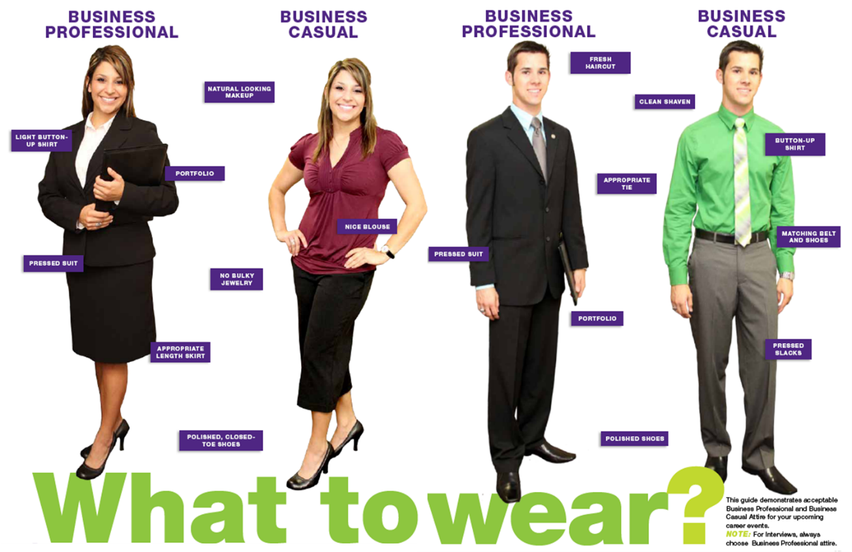
Examples of Dress Attire

Slide 12

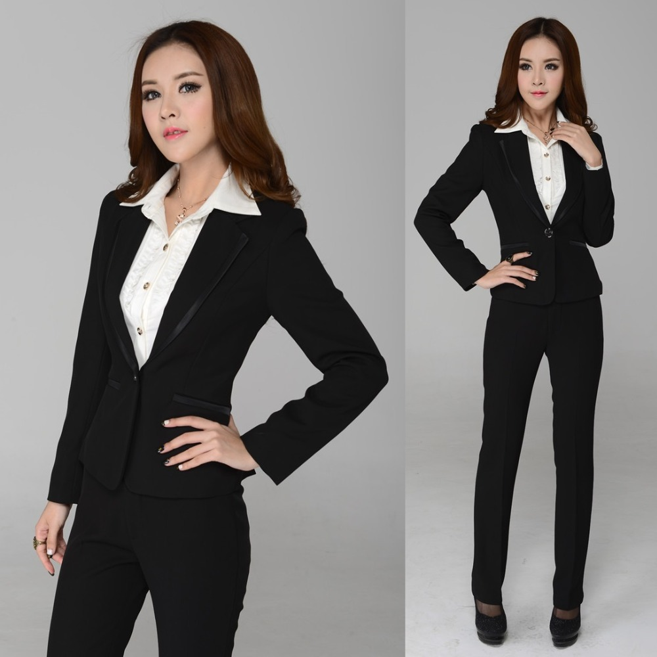

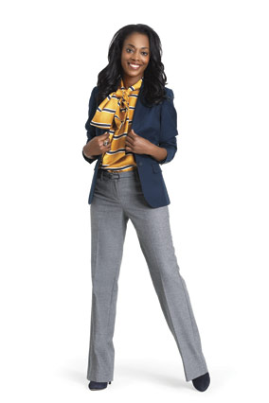




WOMEN

Slide 13




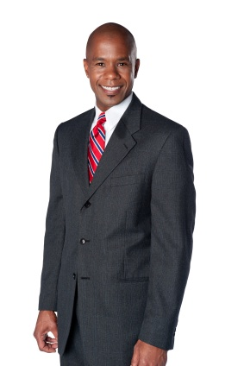
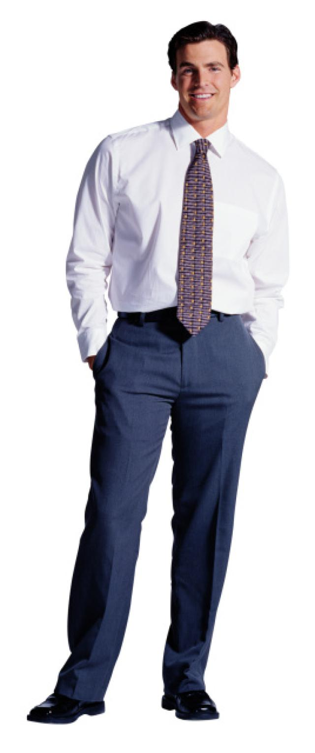


MEN

Slide 14

What to Bring
Copies of your Resume
Transcript (if requested)
References / letters (if requested)
Portfolio
Samples of Work
*If you do not have a portfolio, bring materials in a professional folder

Slide 15
Stages of an Interview
Reception/Lobby (be polite to everyone)
Introduction – aka Greeting
Shake hands, introduce yourself – make sure to smile!
Small Talk – brief and customary in Canada
Discussion of the Company
Employer will typically go over position, a bit about themselves and the company
Q & A – formal interview part
Opportunity to Ask Questions of Company (always have good questions!)
Final Sell!!
Send a follow up Thank You email or LinkedIn message!

Slide 16
DURING THE INTERVIEW
One of the most common reasons that interviews are not successful is the candidate does/did NOT answer the question (s) that was asked!
Remember to stay focused on what the interviewer is asking!

Slide 17
Prepare Questions YOU Could Ask
Training?
Hiring history with the College?
Typical work assignments?
Daily work?
Required travel?
Opportunities for growth?
Remember: Do not ask a question that can easily be answered via their website or job description
Prepare a few questions as interviewer (s) might accidentally answer the questions you were thinking during their introductions!

Slide 18
INTERVIEW TIP
In a written test, if you don’t write down the answer, you don’t get a mark.
The same is true for an interview…if it doesn’t come out of your mouth, you don’t get the points!

Slide 19

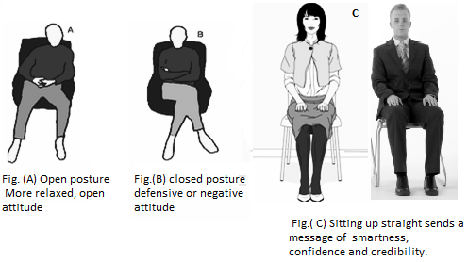
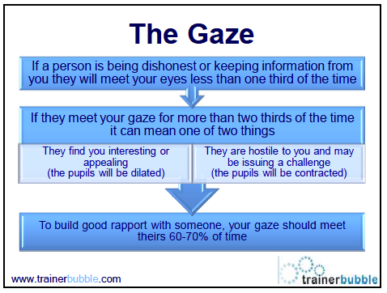
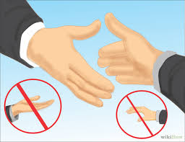
The Importance of Non-Verbal Communication

Slide 20
Telephone Interviews
Plan for a time and place that will minimize distractions
Make sure you have good reception and are in an area that is quiet (easy to hear you)
Speak clearly and not too quick
Sound confident and enthusiastic (as there no visible feedback)
Make sure to SMILE – interviewers can tell
Listen! Don’t interrupt the interviewer!
*Often, telephone interviews are conducted as the first stage of the hiring process; generally quick

Slide 21
SELL Yourself!
Why should we
hire you?
What makes you distinct or different?

Slide 22
TELL ME ABOUT YOURSELF
One of the most popular questions asked in an interview!
Why do employers ask this question?
To see if you’re a good fit for the company
Elevator pitch= 1-2 minutes

Slide 23
TELL ME ABOUT YOURSELF
What not to do:
Personal information/family background
“My dad is an accountant and my mother is a stay at home mom. I have two siblings…”
Restating EXACT information from resume
“For two years I worked in a bank as customer service then I moved and worked at a call center for a few months. I then went back to school for another program…”

Slide 24
Tell me about yourself
What to focus on? Why are you a good fit for the position?
EDUCATION: Focus on qualifications you possess for the position
EXPERIENCE: Relevant experience/knowledge/industry
Highlight: special relevant training, innovative projects, previous promotions
Do not talk about all of your experiences and all of your education - focus on what is relevant to THAT position!

Slide 25
TELL ME ABOUT YOURSELF
Important tip - Include at the end of your answer:
Why are you interested in position right now?
Why are you there?
BAD Example: “The company offers many benefits such as paid co-op positions and that’s what I’m looking for.”
GOOD example: “Based on my research, company XYZ has worked with current and innovative programs such as Cloud which has increased efficiency in documentation. I have recently worked on a project in my recent experience which developed my knowledge in the program.”

Slide 26
Behavioural Based Interviewing
Typical Interview Question:
“What would you do if…?”
This is hypothetical - based on assumption
Behavioural Based Interview Question:
“Tell me about a time when…?”
This is factual – based on actual situations and experiences
Notes:
Explain that the typical interview question is hypothetical – based on assumption
The behavioural based interview is factual – based on an actual situation they have experienced

Slide 27
CREATING A PROOF STORY: BEHAVIOURAL INTERVIEWS
S
T
A
R
= Situation/
= Task
= Action
= Result

Slide 28
ENHANCING YOUR PROOF STORY
DETAILS
ARE
IMPORTANT!
Notes:
Give the what’s, when’s, where’s, and how’s of the situation

Slide 29
SAMPLE QUESTION
“Tell me about a time when you did something difficult or challenging on your own.”

Slide 30
SITUATION / TASK
“I decided to go back to school when I was 25 years old. I had been out of high school for 7 years. I was finding doing college level math after being away from school for so long quite a challenge.”

Slide 31
ACTION
“I was determined to succeed so I hired a tutor that I met with twice a week, was diligent to do my homework & assignments thoroughly and on time, and I put in whatever extra work I had to do to succeed. This meant watching extra videos and tutorials and meeting with my professor for extra help too.”

Slide 32
RESULT
“As a result, I not only passed my math course, I got an A! The experience taught me a valuable lesson, and that level of problem solving and determination is something I will bring to the workplace as well.”

Slide 33
The Day of the Interview
You have researched the company!
You have done a mock interview!
You are properly dressed!
You’re early for your interview!
BE CONFIDENT!
YOU ARE
PREPARED!

Slide 34
16 Ways to Mess Up An Interview
The Do and don’ts of Interviewing:
https://www.youtube.com/watch?v=Jg3AObbTRwY
Notes:
In-Class Activity: Watch in class – a funny video titles “16 ways to screw up an interview”

Slide 35
Interview Success
A great video re: interview success and tips
http://www.careerplayer.com/tips-and-advice/general-advice/interview-tips/
Notes:
Watch on their own

Slide 36
Video Examples:
“Tell me about yourself”
https://www.youtube.com/watch?v=m5kR7TPAkSw
“Tell me about yourself” – Good vs. Bad
https://www.youtube.com/watch?v=Cyww7eRVj3E
“Describe a weakness you have”
https://www.youtube.com/watch?v=2mc2B8NZhvY
“Why do you want to work for us?”
https://www.youtube.com/watch?v=FHDVQkU-nGI
Snagajob has a few other great videos too!

Slide 37
Links – Common Behavioural Interview Questions
https://www.thebalance.com/top-behavioral-interview-questions-2059618
https://biginterview.com/blog/2011/09/tell-me-about-yourself.html
https://hr.ok.ubc.ca/__shared/assets/Common_Behavioural_Interview_Questions23153.pdf

Slide 38
Week #8 – Online Work
Read: The following articles:
“How to Sell Yourself in an Interview”
https://biginterview.com/blog/2015/02/how-to-sell-yourself-in-an-interview.html
“Tell Me About Yourself”
https://biginterview.com/blog/2011/09/tell-me-about-yourself.html
Complete: You are interviewing for a Health and Safety position related to OHST (might be easiest to refer back to a job posting you used for the resume/cover letter assignment)
Submit:
Answer the following question:
Tell us about yourself?
Using the STAR method discussed in class choose/ answer ONE of the following questions;
Give a time in which you set an important goal in the past and tell me about your success in achieving it.
Tell me about a time at work or school when you have worked on a team?
Relate a time in which you had to use your verbal communication skills in order to get an important point across?
Notes:
Update to make it relatable to your program

